Slide 1


How an Online Data Science Degree
Can Boost your Career
Anish Mahapatra | 9 February, 2022

Slide 2

Agenda
01
Introduction
02
What is Data Science?
03
Components and comparison of an Online Degree
04
How to build your profile
05
FAQs and Course Highlights
06
Let’s Talk!

Slide 3











Topic 1 of 6
Introduction: Am I worth your time?
Mentored over 2000+ people in Data Science
Senior Data Scientist at a Fortune 200 company
Writer, Teacher, Webinar Expert in Data Science
Consultant to 7+ Fortune 500 companies
Subject Matter Expert in multiple Data Science Topics including Chatbots, Kafka, ML & AI
PGD from IIIT Bangalore + MSc in Data Science
6 years of experience in Data Science
Lead Data Scientist
LinkedIn: www.linkedin.com/in/anishmahapatra Medium: anishmahapatra.medium.com Website: www.anishmahapatra.com
GitHub: www.github.com/anishmahapatra
Q. How to get into Data Science?
A. Simple, ask a real-world Data Scientist.

Slide 4



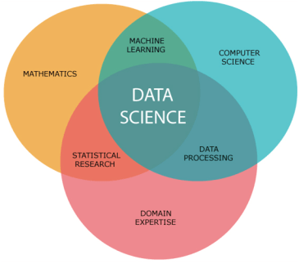
Topic 2 of 6
What is Data Science?
01
02
03
Mathematics
Business
Technology
Understanding the fundamentals of Data Science requires mathematics
Business is the core of every Data Science problem
Evolving technology is what keeps Data Science ahead of every other industry
Notes:
In Industry 3.0, we automate processes using logic processors and information technology. These processes often operate largely without human interference, but there is still a human aspect behind it. Where Industry 4.0 comes in is with the availability and use of vast quantities of data on the production floor.

Slide 5
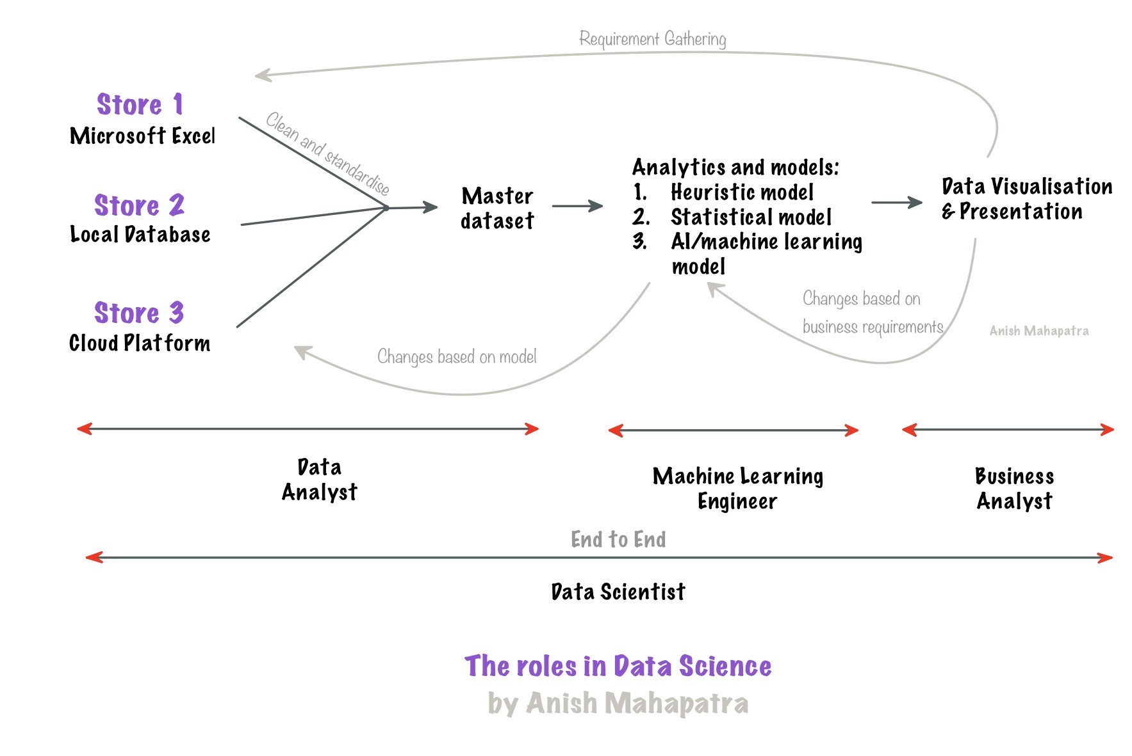
Topic 2 of 6
What is Data Science?

Slide 6




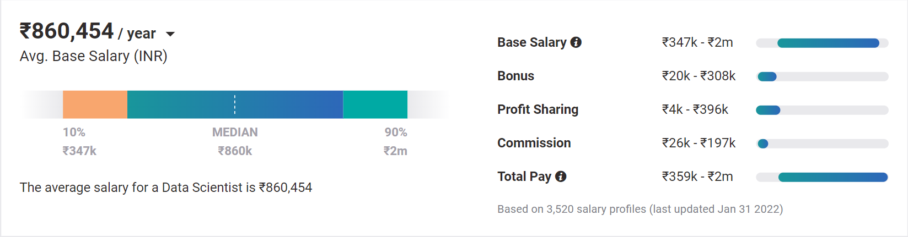
Topic 2 of 6
Why choose Data Science?
01
02
03
Relevance in the future
Business & Technology
Industry-Agnostic
Companies are building and growing in Data and it is the future.
Data Science is a combination of Business, Math and Technology, so growth can be in business / technology
Use your existing knowledge / domain / technology expertise with a data-edge
04
Extremely High Market Demand
Supply-Demand mismatch means companies are willing to pay more
Notes:
Source:https://www.payscale.com/research/IN/Job=Data_Scientist/Salary

Slide 7





Topic 3 of 6
Components of an Online Degree
1. What do you really want from a Degree?
01
02
All Companies should
recognize my degree
My Degree should be
Recognized globally
Companies like Amazon, Microsoft, Fortune 500:
all recognize this as a full-fledged
Post graduate and Master’s Degree
India or Abroad, everyone should recognize my degree. This is possible because of the WES Certification
04
03
I should be able to get a transition my job or get a jump in my salary
Possibility of
Higher Studies
On Average, having a relevant MSc Degree will get you 40% more in the market
If you wish, you should be able to pursue even higher degrees later
Notes:
Source:https://www.payscale.com/research/IN/Job=Data_Scientist/Salary

Slide 8





Topic 3 of 6
Components of an Online Degree
2. Can I do the degree and a full-time job?
01
02
The Course is designed specifically for working professionals
Everything is online!
The course is designed to help you get a job, with the primary focus on real-world skills and interviews
The entire course is based online, and there is extreme learning – both on the app and website
03
04
For the first time in your life, you are looking to do something for yourself
Everything you learn
is relevant to the industry
The course is not easy, and will test you. However, you will be able to do it because your mindset is different – top 5%
UpGrad will help you with 70% of the course, the rest 30% is on you.
Notes:
Source:https://www.payscale.com/research/IN/Job=Data_Scientist/Salary

Slide 9





Topic 3 of 6
Components of an Online Degree
3. How does the course actually work and is it really beneficial?
01
02
Course is taught by professors and Industry Professionals
Real-world learning through Hands-On Work
This helps keep the learning relevant and helps you understand on what is the latest in the industry as well with real-world examples
Hands-on projects and course work will keep you on your feet. You will have to learn and implement to progress in the course.
04
03
Three-Level System to make sure
your doubts are cleared
upGrad will help give you support for your job search
Instant Q&A Forum, Live Classes and Small Group Coaching will ensure that you get the support you need
Unlimited Mock Interviews, Interview Coaching and Career Coaching along with multiple webinars
Notes:
Source:https://www.payscale.com/research/IN/Job=Data_Scientist/Salary

Slide 10





Topic 3 of 6
Components of an Online Degree
4. Why did you choose upGrad and was it actually helpful?
01
02
Wanted a real degree,
not a certificate
Wanted to do industry projects to understand
No other company in the market offers a WES certified degree
You can get some amount of theory online, the examples and real-world projects helped me answer interview questions
03
04
Did not want to
leave my job
Wanted a MSc Degree while getting all the benefits of doing it offline
Getting a degree at a fraction of the cost, while working. All I cared about is the ROI – both short-term and long term
I was able to get all the benefits of a full-fledged Master’s degree. Perhaps, I did not get the networking component as much
Notes:
Source:https://www.payscale.com/research/IN/Job=Data_Scientist/Salary

Slide 11
Topic 3 of 6
The Main Question
So, was it worth it to get a degree in Data Science?
Did it help in the real-world?
Notes:
Source:https://www.payscale.com/research/IN/Job=Data_Scientist/Salary

Slide 12
Topic 4 of 6
How to leverage a degree to get there?
01
02
03
Set Target
Talk to people
Build LinkedIn Profile
Understand the Data Field,
Understand roles & responsibilities,
Look at a 5-year path
Talk to people who are already doing what you want to do
Add certifications, participate in competitions, do simple projects, look at how the best of the best do it
06
05
04
Build Collaterals & Profile (30%)
Globally Accepted Degree (70%)
Explore Certifications
Multiple certifications don’t help, the quality of it does.
GitHub, LinkedIn,
Medium, Brand Profiling
Globally recognized degree, Degree Accepted by MNCs,
Possibility of PhD later,
Alumni Status
Bonus - WES Certification, Teachers from the industry
Notes:
All we care about is how to get a job, let me tell you how to leverage MSc to get a job!

Slide 13



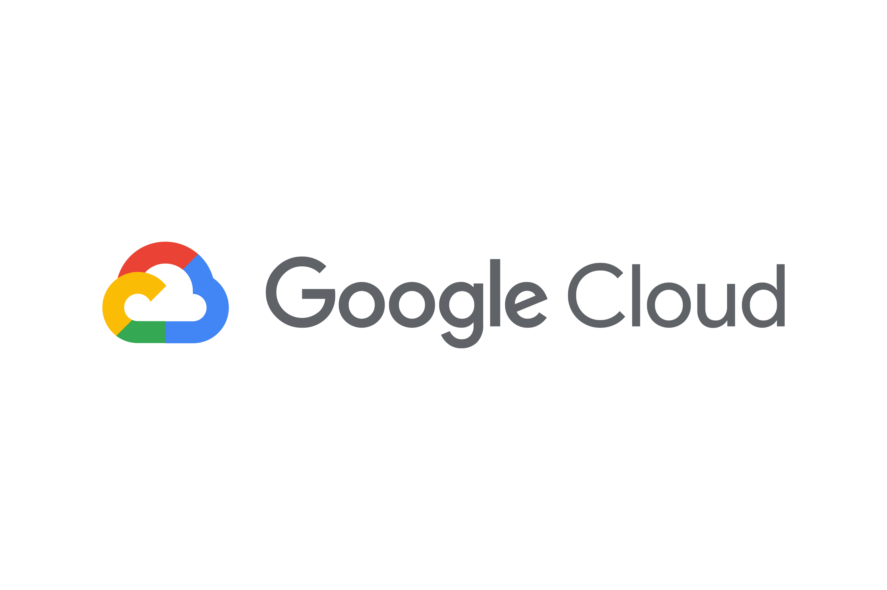










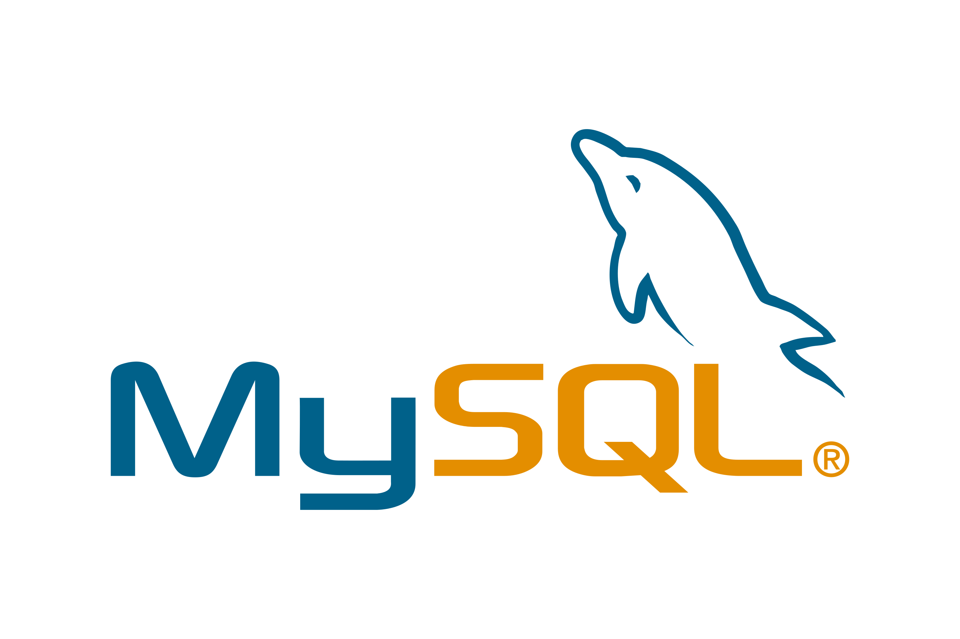

Topic 5 of 6
Tools & Technologies in Data Science
Data Analyst
Machine Learning Engineer
Business Analyst
Data Scientist

Slide 14
Topic 4 of 6
FAQs
1. Will UpGrad give me a job?
2. What if UpGrad stops responding after I register?
3. What is the difference from doing a course offline or abroad?
4. When should I do the course?

Slide 15






Topic 5 of 6
Resume Optimization

Slide 16
Key Takeaways
01
Introduction
02
What is Data Science?
03
Components and comparison of an Online Degree
04
How to build your profile
05
FAQs and Course Highlights
06
Let’s Talk!

Slide 17

Data Science vs. Data Analytics
Anish Mahapatra
Let’s Talk!
LinkedIn: www.linkedin.com/in/anishmahapatra
Email: anishmahapatra01@gmail.com

